Slide 1
FINSIGHT: ENTERPRISE CREDIT RISK ANALYTICS & AUTOMATED LOAN UNDERWRITING ENGINE
KL UNIVERSITY (KLH)
Final Project Review | KL University (KLH)
TEAM MEMBERS
2420030609 – RAJENDRA
2420030615 – MALLIKARJUN
2420030370 – PRAVEEN
Guide: Dr. N. Sunanda | KL University (KLH)
Notes:
Introduce FinSight, the team and the guide.

Slide 2



Introduction & Problem Statement
48 h → < 2 s
Loan decision turnaround: manual review vs. FinSight
Background
Lenders score thousands of loan applications using bureau, income and repayment data. Manual underwriting is slow, inconsistent and hard to audit.
4.2% → 3.1%
Portfolio default rate, Q1 to Q4 (dashboard)
Problem Statement
No single data-driven system scores risk consistently, explains each decision and applies lending policy automatically; teams use spreadsheets and disconnected tools.
68 · 17 · 15 %
Approved · Referred · Rejected outcome mix
Motivation / Need
Wrong calls are costly: rejecting good borrowers loses revenue, approving risky ones creates bad debt. RBI and Basel also demand auditable decisions.
Notes:
Domain, problem and why it matters; the three stat cards come from the FinSight dashboard.

Slide 3


Objectives & Scope
Objectives
In Scope
1
Build a data pipeline that ingests and cleans applicant, bureau and transaction data, and engineer risk features (DTI, LTI, repayment history).
10,000-record synthetic applicant dataset
3 scoring models, SHAP explanations, policy engine
Dashboard, batch ingestion, audit certificate
2
Develop and compare Logistic Regression, Random Forest and XGBoost scorers on AUC-ROC, KS, precision and recall.
3
Design an automated underwriting engine that applies policy rules to issue approve / refer / reject decisions.
Out of Scope
Live bureau and core-banking integration
Real customer data, production deployment
Automated retraining and drift monitoring
4
Integrate SHAP explainability and an interactive dashboard so decisions are auditable and portfolio risk is monitored.
Notes:
Four objectives; scope is a synthetic-data prototype, not a production bank system.

Slide 4

Literature Survey
S.No | Author(s) & Year | Method / Technique | Key Findings | Limitation / Gap
1 | Breiman, 2001 | Random Forest ensemble | Bagged trees give robust, accurate predictions | Hard to explain individual decisions
2 | Chen & Guestrin, 2016 | XGBoost gradient boosting | Scalable, state-of-the-art accuracy on tabular data | Black box; needs an explanation layer
3 | Lundberg & Lee, 2017 | SHAP attributions | Consistent per-prediction feature contributions | Explains a model only; no decision policy
4 | Lessmann et al., 2015 | Benchmark of 41 classifiers on credit data | Ensemble methods outperform single classifiers | Compares scorers; no end-to-end underwriting
Research Gap
Existing work scores risk or explains models in isolation, while bureau scores, manual review and rule-based systems are narrow, slow or rigid. FinSight unifies ML scoring, SHAP explanations and a configurable policy layer in one auditable pipeline (Objectives 1–4).
Notes:
Four prior works: Random Forest, XGBoost, SHAP and a credit-scoring benchmark. Gap: nothing unifies scoring, explanation and policy.

Slide 5





Proposed System & Methodology
STEP 1
STEP 2
STEP 3
STEP 4
STEP 5
Define Problem
Collect Data
Design
Implement
Test & Evaluate
Scope credit-risk underwriting; set goals: AUC, KS, explainability.
10,000 synthetic applicant records: bureau, income, EMI, utilisation.
Pipeline: features → ML scoring → SHAP → policy engine.
React + TypeScript app, scoring and policy services, Python ML script.
Compare 3 models on AUC, KS, precision, recall; scenario tests.
Key Novelty / Contribution
FinSight joins ML scoring, SHAP explanations and a configurable policy-rule layer in one engine, so every approve / refer / reject decision is fast, consistent and backed by an auditable certificate.
Notes:
Five-step methodology; novelty is the unified, explainable, policy-driven engine.

Slide 6
System Architecture
INPUT
Applicant profile · Bureau (CIBIL) score · Income & EMI · Bank conduct · Loan request
Components
1
Data Ingestion & Features
Bureau, income and EMI data → DTI, LTI
Data & Features
DTI, LTI, utilisation, delinquency
ML Scoring + SHAP
PD from XGBoost / RF / LR; factor attribution
Policy Engine
5 knockout rules + PD cut-offs
1
2
3
2
ML Scoring & SHAP
Probability of default and factor attribution
3
Policy Underwriter
Rules and PD cut-offs → decision, APR
OUTPUT
Approve / Refer / Reject · Risk grade & APR · Audit certificate
4 Dashboard & Batch Monitoring
Portfolio KPIs · decision mix · default-rate trend · CSV export
4
Dashboard & Audit
Portfolio KPIs, batch ETL, certificates
Notes:
Walk input → features → ML scoring + SHAP → policy engine → output, then the dashboard.

Slide 7


Hardware & Software Requirements
Hardware
Software & Tools
Libraries / Frameworks
Standard laptop or desktop PC
No GPU required
Modern web browser (Chrome / Edge)
Internet only for web fonts
OS: Windows / macOS / Linux
Node.js + npm (Vite 6 build tool)
TypeScript 5.7, Python 3
Tailwind CSS 3.4, PostCSS
React 18.3
Recharts 2.15 (charts)
Lucide React 0.475 (icons)
NumPy (ML evaluation script)
Deployment / Platform: Static web build (Vite) in any browser; Python ML script runs locally
Notes:
Software stack and requirements actually used in the project.

Slide 8
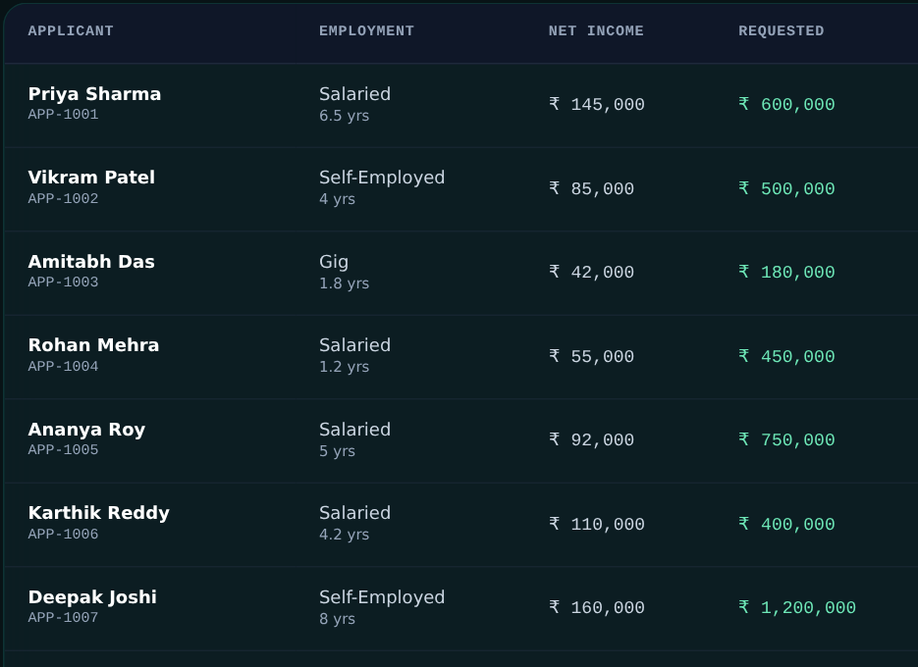
Dataset / Data Understanding
10,000
11
Records (rows)
Features (9 raw + 2 derived)
0
2
Missing values
Target classes
Source: Synthetic applicants (Python, NumPy, seed 42)
Features: CIBIL, income, EMI, loan, utilisation, delinquencies, DTI, LTI → default
Quality: No missing values; about 36% defaulters
Batch Ingestion screen: sample applicant records scored by the app.
Notes:
10,000 synthetic applicants, 11 features, about 36% defaulters; the screenshot shows the app’s batch ingestion table.

Slide 9
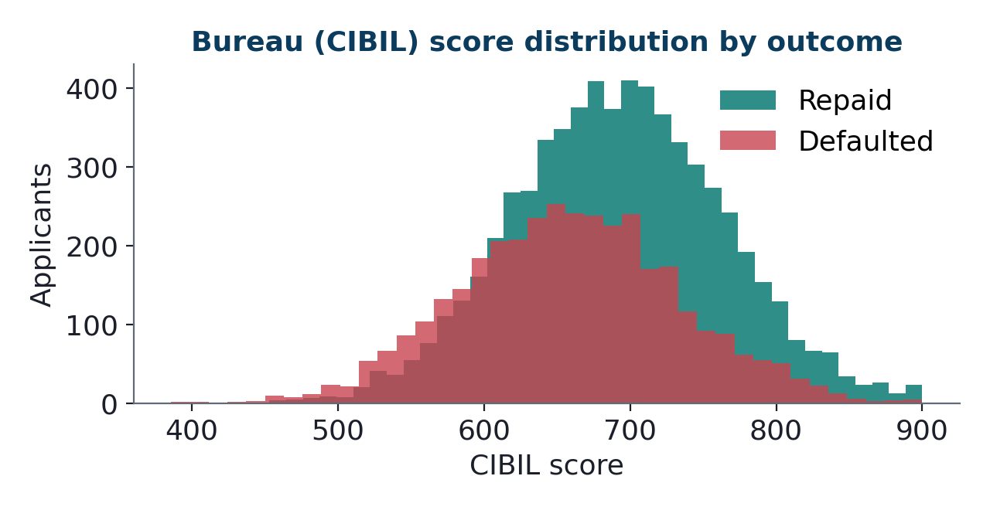
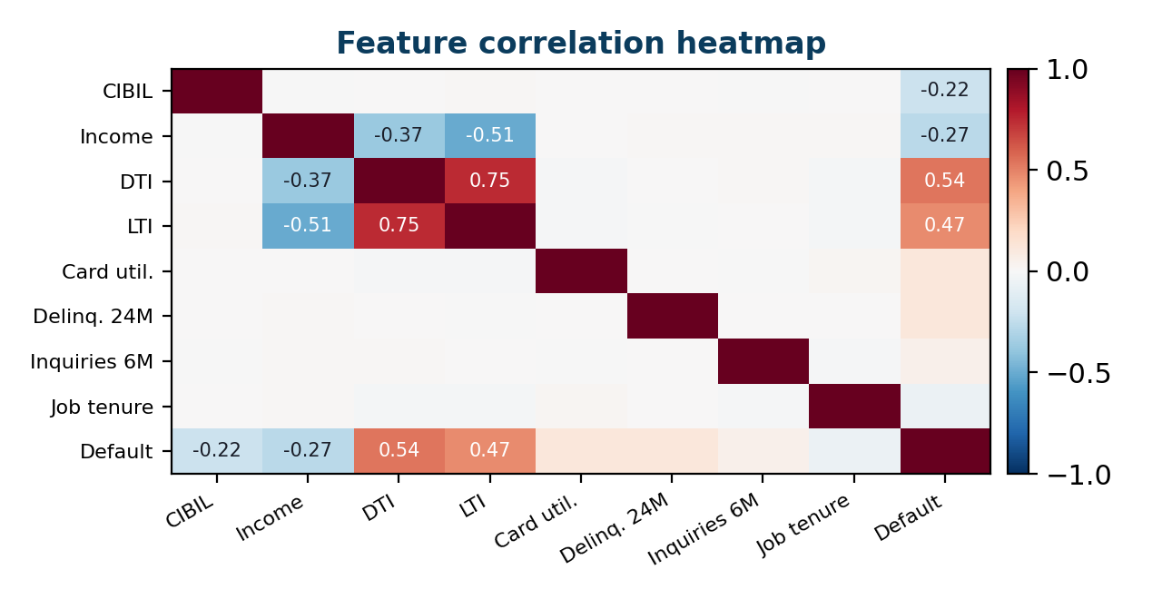



Data Preprocessing & Exploratory Analysis
Cleaning
Transformation
Feature Selection
No missing values in the generated data; values clipped to valid ranges (e.g. CIBIL 300–900).
New EMI at 12% p.a. → DTI and LTI ratios; features standardised for scoring.
11 candidate features; bureau score, DTI, delinquencies and utilisation matter most.
Notes:
Distribution and correlation plots regenerated from the project’s data generator (seed 42).

Slide 10
Module-wise Description
1
Data Ingestion & Features
2
ML Scoring Engine
Purpose: Load, clean data; compute DTI and LTI
Input → Output: Raw applicant data → feature vector
Developed by: Mallikarjun (data pipeline)
Purpose: Estimate PD with XGBoost, RF, LR
Input → Output: Features → PD, 300–900 score, grade
Developed by: Rajendra, Mallikarjun (ML models)
3
Policy & Underwriting Engine
4
Dashboard, Batch & Audit
Purpose: Apply knockouts and PD cut-offs
Input → Output: PD + score → decision and APR
Developed by: Praveen (policy engine)
Purpose: KPIs, batch scoring, SHAP certificate
Input → Output: Decisions → charts, CSV, certificate
Developed by: Rajendra (app), Praveen (SHAP)
Notes:
Four modules; individual ownership to be stated by each member.

Slide 11

Algorithms & Technologies Used
Logistic Regression
Random Forest
XGBoost (Champion)
Why chosen
Transparent coefficients; regulatory baseline.
Key parameters
L2 regularised linear model; AUC 0.768, KS 38.4%.
Why chosen
Robust to outliers; captures threshold effects.
Key parameters
Bagged decision trees; AUC 0.832, KS 46.1%.
Why chosen
Best separation; models DTI × utilisation interactions.
Key parameters
Gradient-boosted trees; AUC 0.884, KS 52.6%.
Selection criteria: highest AUC-ROC and KS-statistic; explainable with SHAP
Notes:
Why each of the three models was used and how XGBoost was selected.

Slide 12
Implementation / Model Building
Feature Selection
Key code (ml_pipeline/train_models.py)
9 raw inputs plus DTI and LTI: bureau score, income, EMI, utilisation, delinquencies, inquiries.
# DTI and LTI features
r = 0.12 / 12
new_emi = loan*r*(1+r)**n / ((1+r)**n - 1)
dti = (existing_emi + new_emi) / income * 100
lti = loan / (income * 12)
# latent default probability
logit = (-3.2 - 0.012*(cibil-650)
+ 0.045*(dti-35) + 0.85*delinq
+ 0.22*inquiries + 0.35*lti ...)
p_default = 1 / (1 + np.exp(-logit))
Preprocessing Pipeline
Clip to valid ranges; compute new EMI at 12% p.a.; derive DTI and LTI; standardise.
Data Splitting
80 / 20 train–test split of 10,000 records (8,000 train / 2,000 test).
Configuration
Seed 42; PD cut-offs: approve ≤ 4.8% and score ≥ 665, reject > 10.5%; 5 knockout rules.
Notes:
Feature, preprocessing and split choices, with the key code from train_models.py.

Slide 13
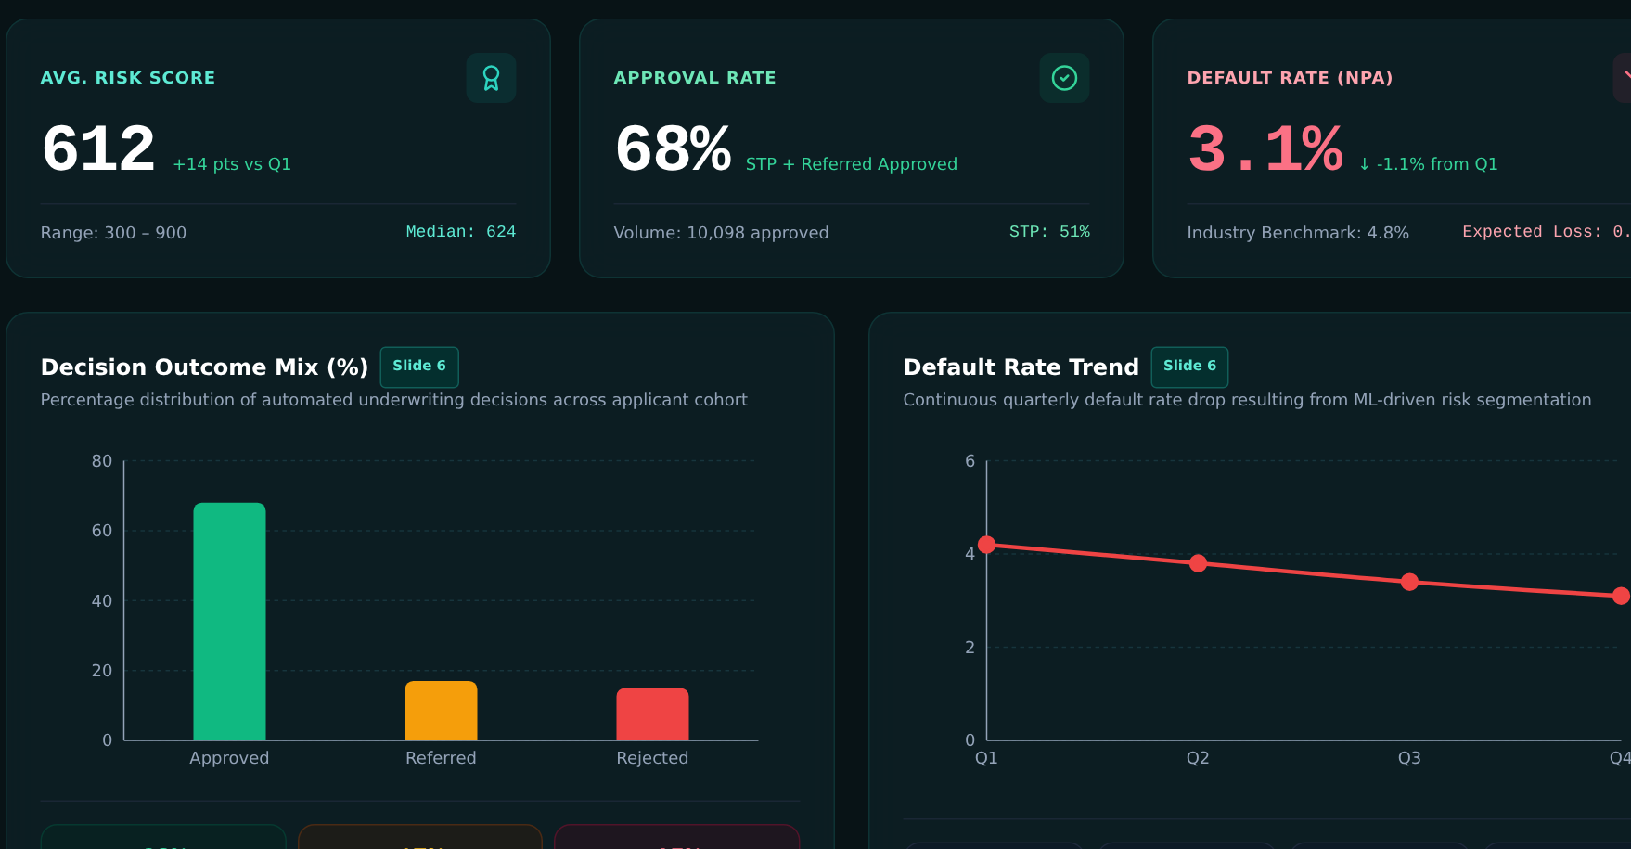
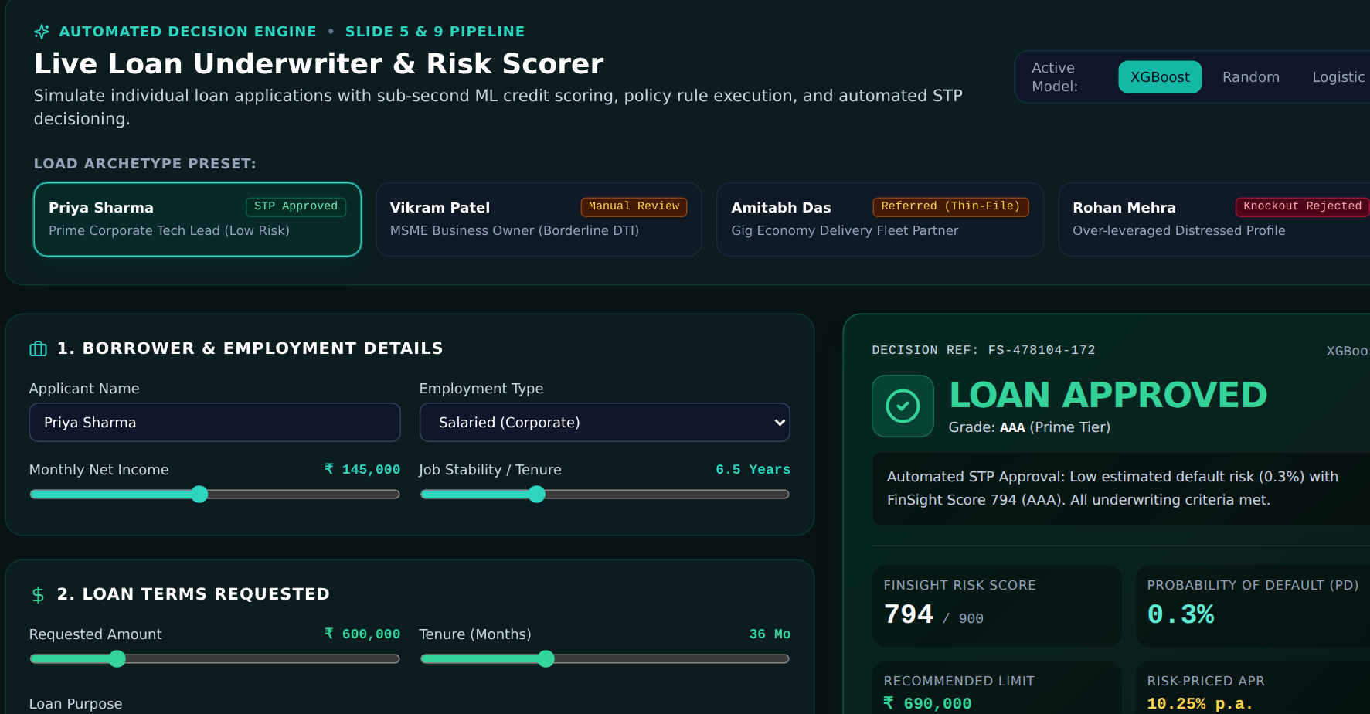
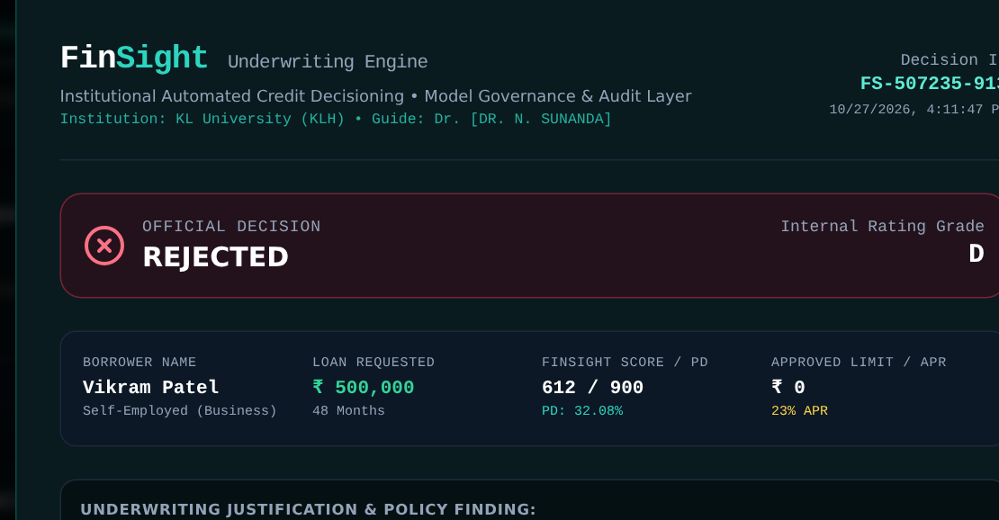
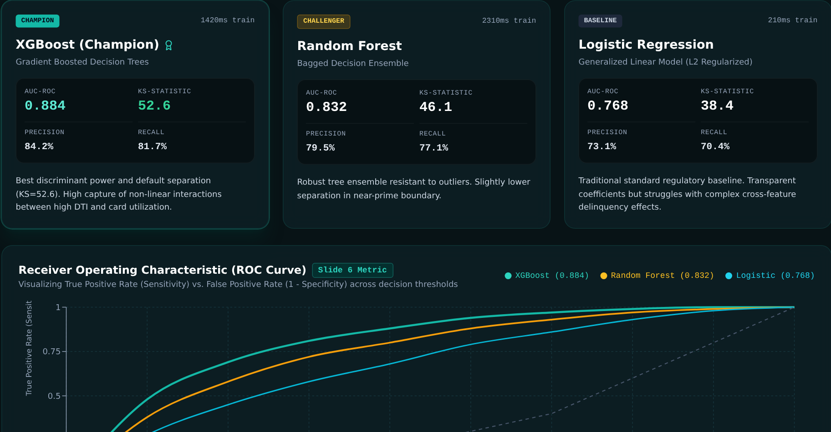
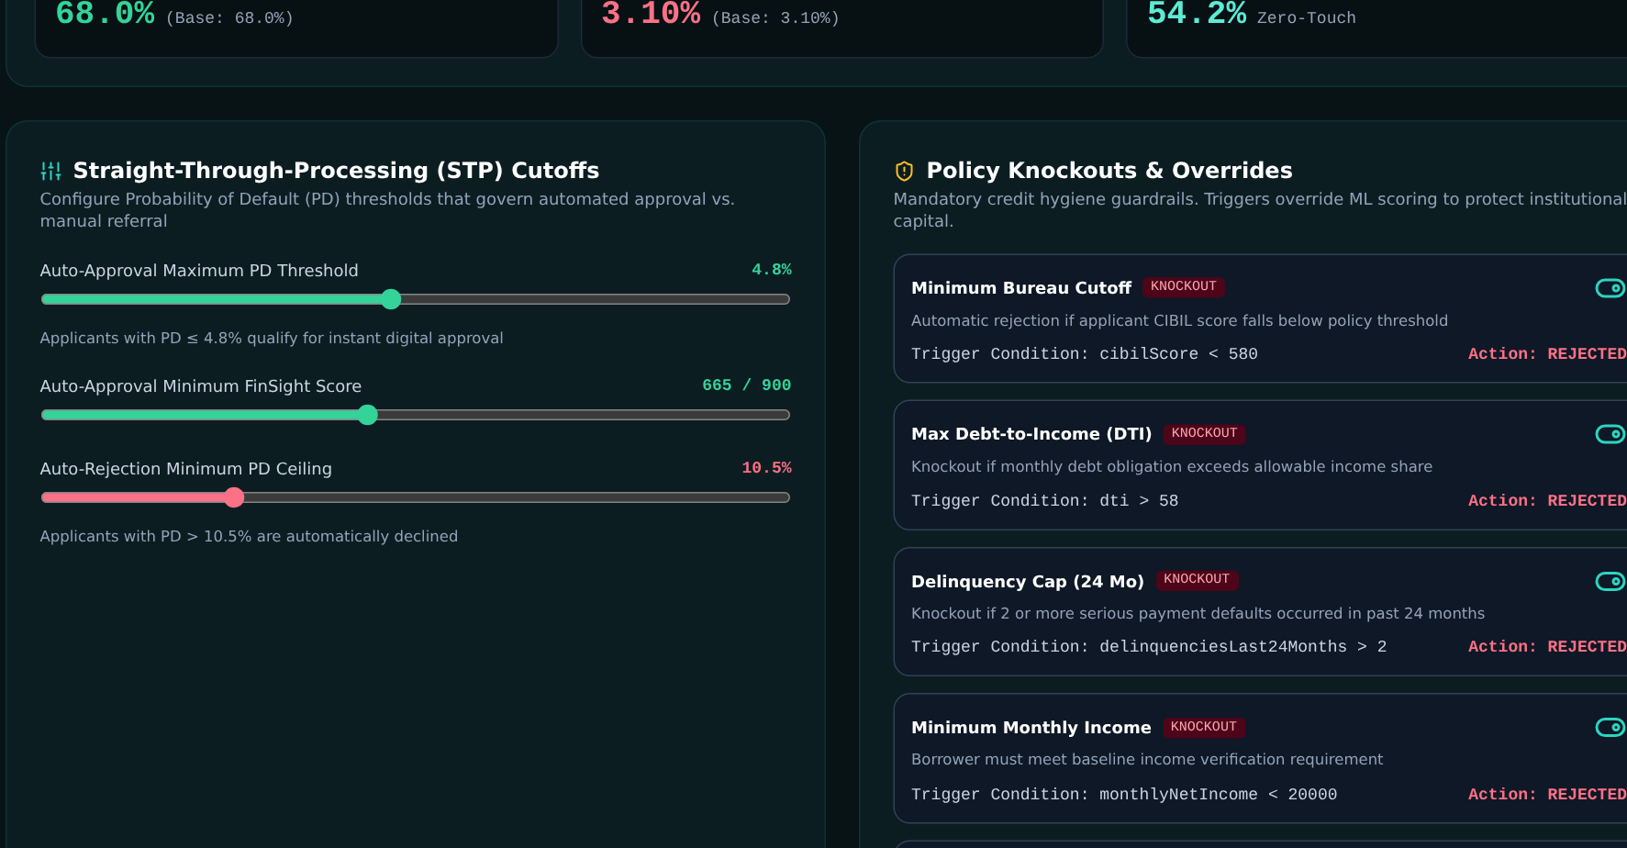
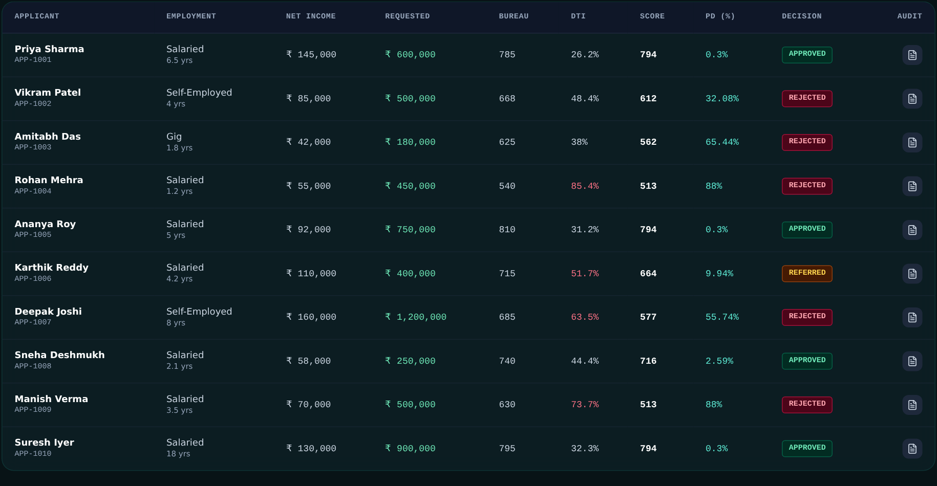
Working Prototype / Output Screens
Portfolio Analytics
Avg. score 612, 68% approval, 3.1% default rate
Live Underwriter
Archetype presets, sliders and instant decision
Audit Certificate
Decision, borrower facts and SHAP factors
Model Benchmarks
XGBoost, RF and LR metrics with ROC curves
Policy Rules
Knockout rules and PD cut-offs, editable live
Batch Ingestion
Applicants scored in bulk with decision filters
Notes:
Six real screenshots from the running FinSight application.

Slide 14
Results & Performance Comparison
Metric | LR | RF | XGB
Accuracy | 0.775 | 0.828 | 0.871
Precision | 0.731 | 0.795 | 0.842
Recall | 0.704 | 0.771 | 0.817
F1-score | 0.717 | 0.783 | 0.829
ROC-AUC | 0.768 | 0.832 | 0.884
Best: XGBoost – AUC-ROC = 0.884
Values from the FinSight evaluation pipeline (ml_pipeline/train_models.py). KS-statistic: XGBoost 52.6%, RF 46.1%, LR 38.4%.
Notes:
Model comparison across accuracy, precision, recall, F1 and AUC; XGBoost is the best.

Slide 15
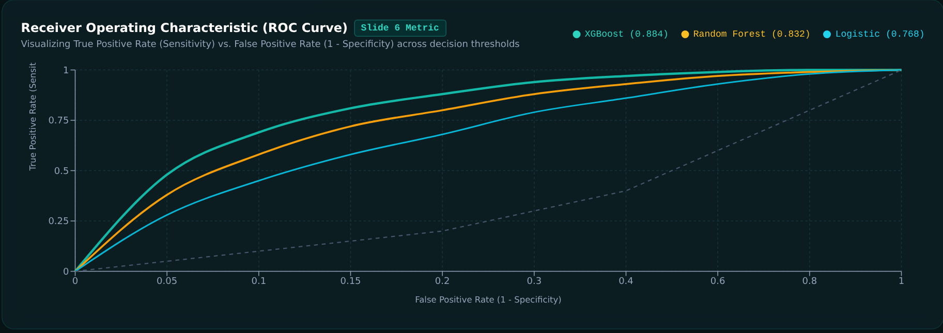
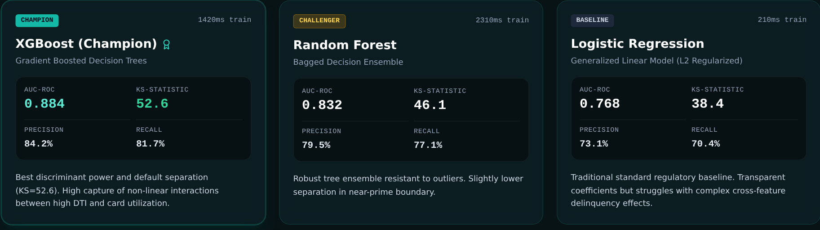
Analysis & Key Findings
0.884
Best AUC-ROC, achieved by the XGBoost champion model
Interpretation: XGBoost beats the logistic baseline by 0.116 AUC (KS 52.6%).
Error analysis: Near-prime band (PD 4.8–10.5%) is hardest; sent to manual review.
Key drivers: Bureau score 32.4%, DTI 24.1%, delinquencies 18.6%, utilisation 11.5%.
Notes:
ROC curve and model cards from the Model Benchmarks screen; explain the near-prime error band.

Slide 16

Testing & Validation
Test ID | Test Description | Expected Result | Actual Result | Status
TC-01 | Prime salaried applicant (CIBIL 785) | Approve | Approved: score 794, PD 0.3% | Pass
TC-02 | Policy knockout (CIBIL 540) | Reject on rule | Rejected: CIBIL < 580 rule fired | Pass
TC-03 | Audit certificate for a rejected case | Certificate with SHAP factors | Generated with decision ID, SHAP list | Pass
TC-04 | Batch scoring of 10 applicants | All 10 scored with decisions | 10 scored: 4 approved, 1 referred, 5 rejected | Pass
Functional Testing
Validation Method
Performance Testing
Presets, sliders, policy rules, batch table and certificate exercised in the browser.
80 / 20 hold-out split; archetypes from prime to knockout.
Instant in-browser scoring; AUC 0.884, KS 52.6%.
Notes:
Four tests run in the browser, all passed.

Slide 17


Challenges & Limitations
Challenges Faced
Limitations
Imbalanced defaults (~36%) → tracked AUC, KS, precision, recall
Black-box scores → added SHAP factors and audit certificate
Rigid rules vs. flexible models → policy layer on top of PD
Synthetic data only; no real bureau or bank records
Benchmark metrics are fixed in train_models.py; the app uses calibrated scoring functions, not live-trained models
Referral band needs calibration: sample “manual review” profiles resolve to reject
Notes:
Be candid: synthetic data, pipeline-based metrics and referral-band calibration.

Slide 18

Conclusion
Built FinSight: ML scoring, SHAP explanations and policy-driven underwriting on 10,000 applicant records.
1
Final Outcome
XGBoost beat Random Forest and Logistic Regression: AUC 0.884 vs 0.832 / 0.768, KS 52.6% vs 46.1% / 38.4%.
0.884
2
AUC-ROC of the champion XGBoost model
Objectives achieved: 4 of 4
Dashboard, batch pipeline and audit certificates give consistent, auditable decisions instead of manual review.
3
Notes:
Revisit each objective and quote the headline AUC of 0.884.

Slide 19



Future Scope & Applications
Improve Performance
Train on real data; tune XGBoost; add PSI drift alerts
Applications
Banks and NBFCs: loan underwriting
Fintech lenders: thin-file borrowers
Risk teams: portfolio monitoring
Adopters: RBI / Basel-regulated lenders
Expand Data / Features
Alternative data: GST invoices, utility and UPI payments
Deploy & Build an Interface
API gateway to core banking (Finacle, Temenos)
Scale & Secure
Cloud deployment, access control, tamper-proof audit logs
Notes:
Next steps tied to the limitations, then real-world users.

Slide 20
Team Contribution
Reg. No. | Name | Contribution / Modules Handled
2420030609 | Rajendra | Full-stack architecture and ML engineering
2420030615 | Mallikarjun | Credit risk modelling and data pipeline
2420030370 | Praveen | Explainability (SHAP) and policy decision engine
Notes:
Each member explains their own modules: Rajendra full-stack and ML, Mallikarjun risk modelling and data pipeline, Praveen SHAP and policy engine.

Slide 21

References
[1] L. Breiman, “Random forests,” Machine Learning, vol. 45, no. 1, pp. 5–32, 2001.
[2] T. Chen and C. Guestrin, “XGBoost: A scalable tree boosting system,” in Proc. 22nd ACM SIGKDD Int. Conf. Knowledge Discovery and Data Mining, 2016, pp. 785–794.
[3] S. M. Lundberg and S.-I. Lee, “A unified approach to interpreting model predictions,” in Advances in Neural Information Processing Systems 30, 2017, pp. 4765–4774.
[4] S. Lessmann, B. Baesens, H.-V. Seow, and L. C. Thomas, “Benchmarking state-of-the-art classification algorithms for credit scoring: An update of research,” European J. Operational Research, vol. 247, no. 1, pp. 124–136, 2015.
[5] Basel Committee on Banking Supervision, “Basel III: A global regulatory framework for more resilient banks and banking systems,” Bank for International Settlements, Dec. 2010 (rev. Jun. 2011).
Project Links
Code: finsight-credit-engine (React + Python)
Dataset: Synthetic, from train_models.py
Demo: Run with npm run dev
Notes:
IEEE-style references.

Slide 22
THANK YOU
Questions & Discussion
Team FinSight: Rajendra · Mallikarjun · Praveen
Guide: Dr. N. Sunanda | KL University (KLH)
Notes:
Thank the panel and invite questions.

